Slide 1

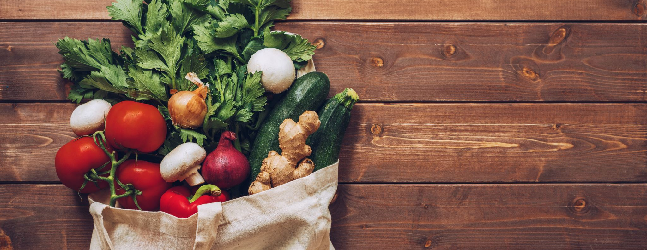


Grocery Inflation
Group 5:
Rebecca Bennett
Max Owens
Samantha Pabalate

Slide 2
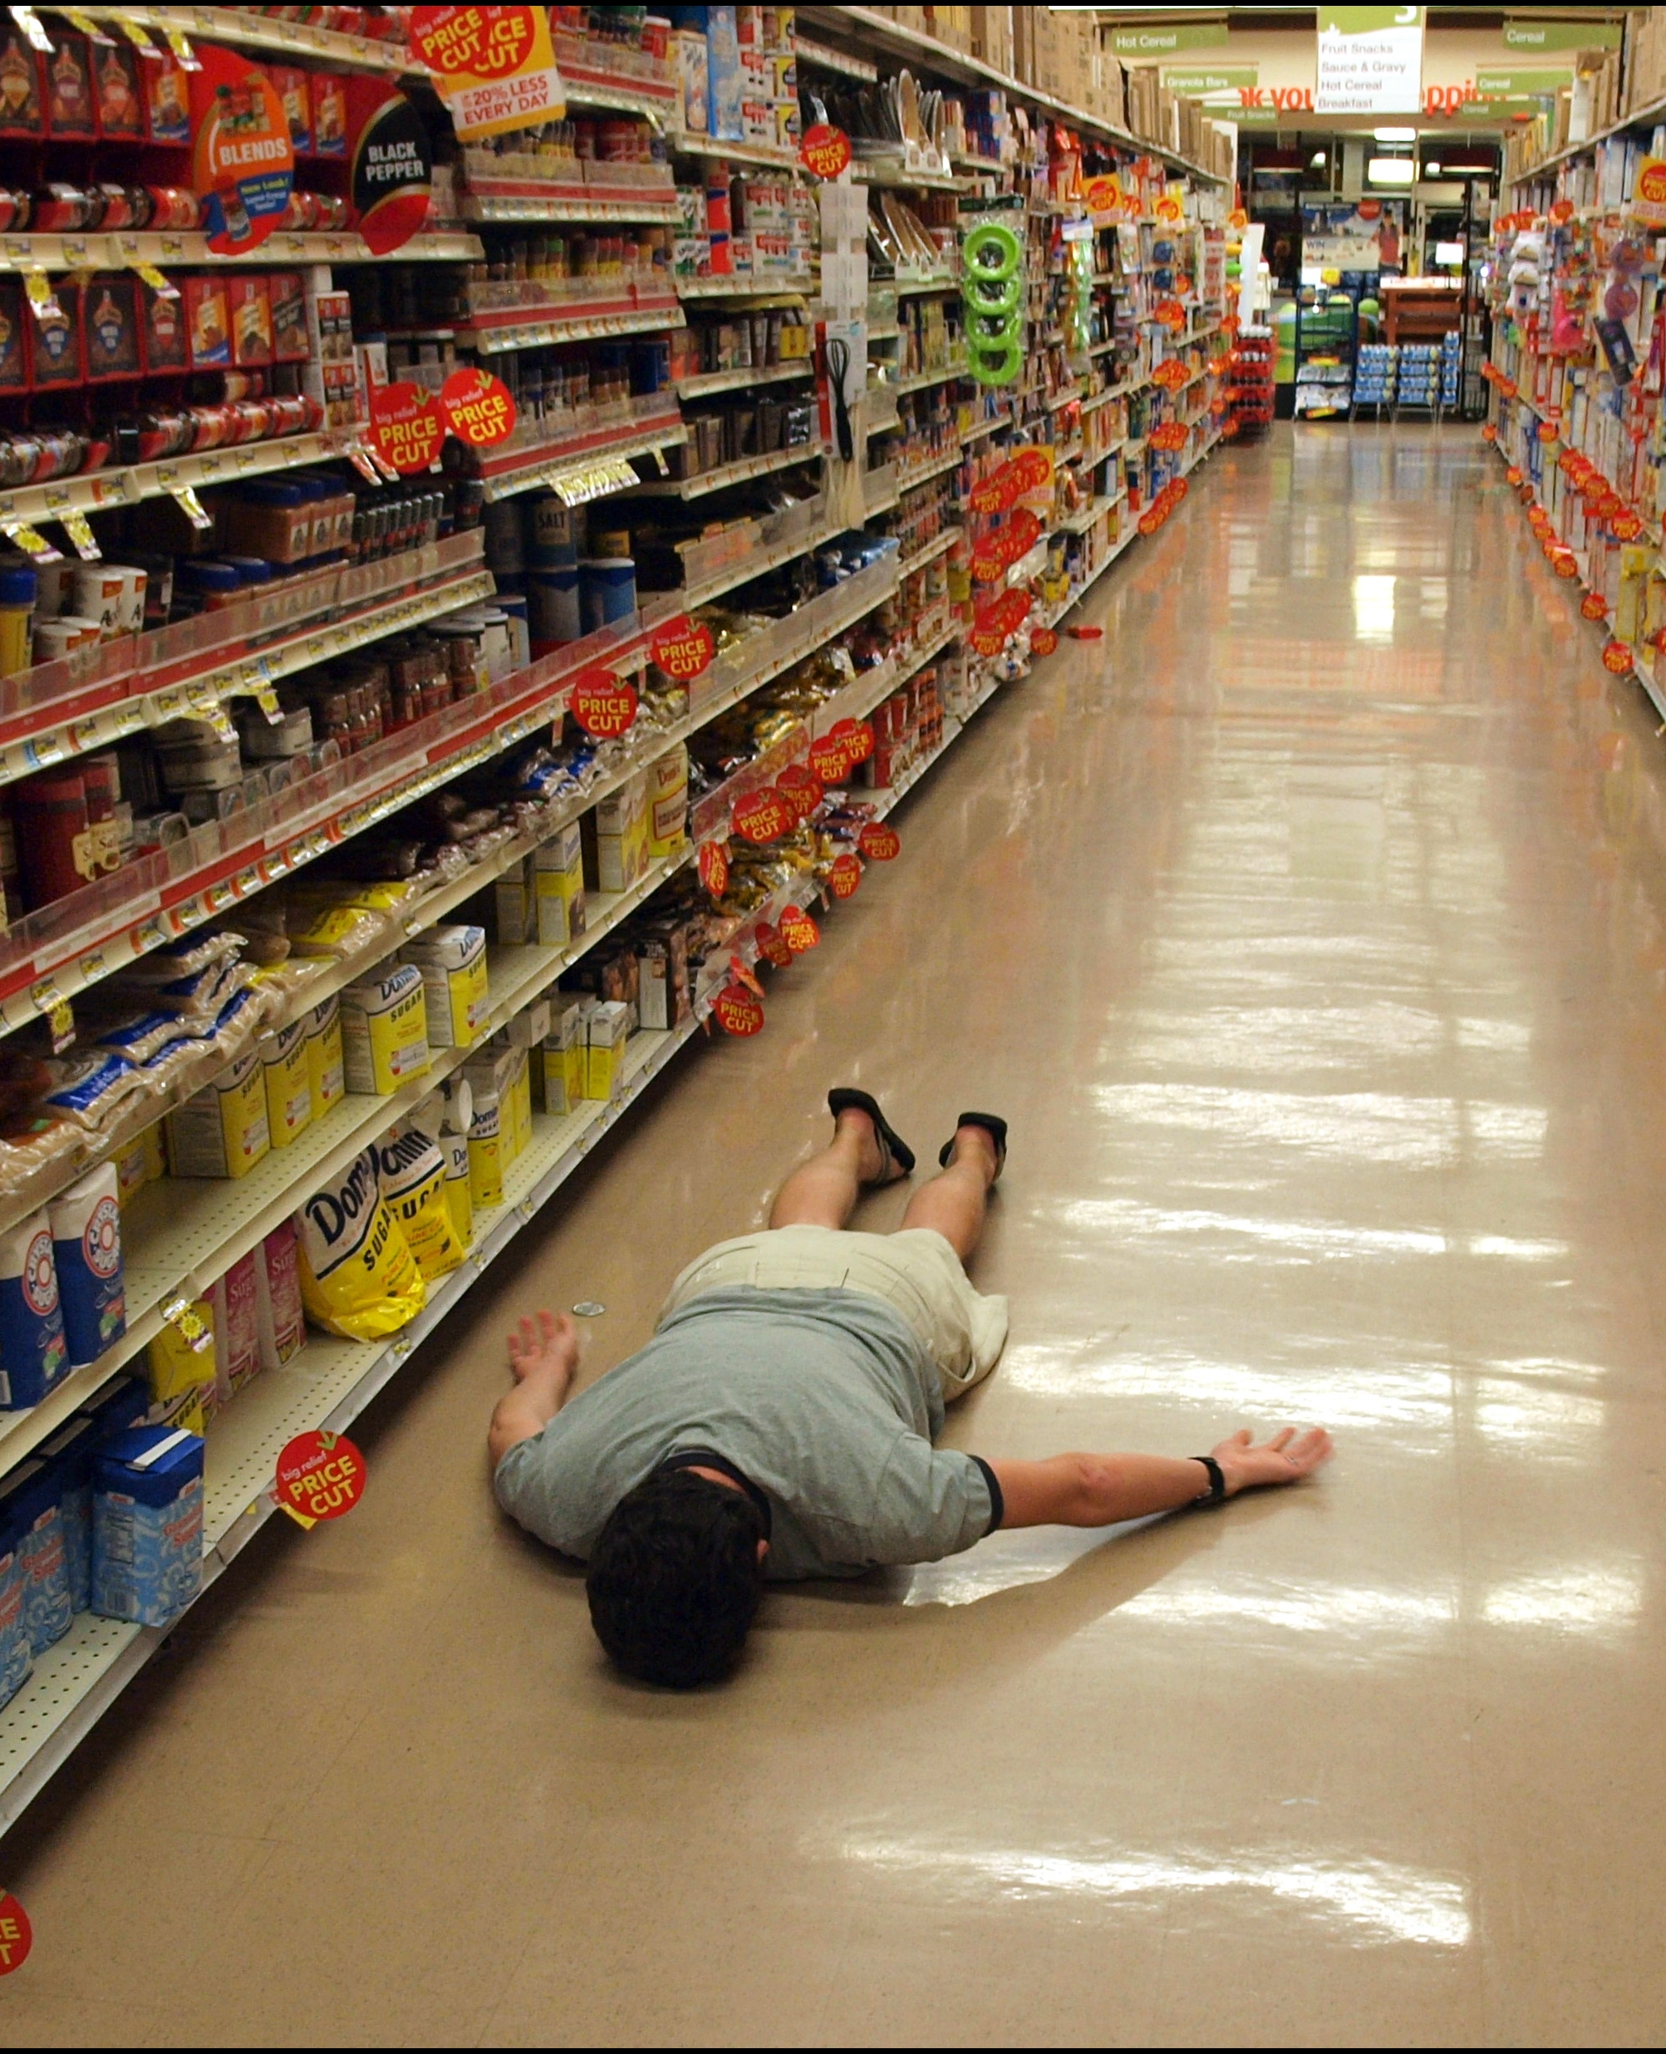
Do you also wonder why eggs are so expensive now?
We took a deeper dive into how much grocery costs have changed over time and in relation to inflation.
Many have us have been affected by these changes recently sparking an interest in historic patterns.
Notes:
What and why?
- Can we get a virtual raise of hands for anyone that has gone to the grocery store this past week or month to pick up some of your staple items, only to find out that the price of that item has increased yet again? Us too.
- Personally, I’ve made the conscious choice to try and eat out less in an effort to save money. However, I couldn’t help but notice my weekly/bi-weekly grocery spending has gone up quite a bit as well.
- We’re all consumers: At the end of the day, if we’re spending our money somewhere, it at the very least will be on food.

Slide 3

Exploring the Different Types of Data
Primarily used two data sets:
Monthly expenditure in the US and regions of California
Consumer Price Index by food category
Both data sets used consumer price indices to track cost changes in goods within the US
Consumer Price Index (CPI) values = price changes in goods and services purchased
Notes:
- Monthly expenditure data set included several categories such as housing, medical care, transportation and we specifically pulled from the “food at home” category
- CPI :
- a measure of inflation experienced by consumers
- can be used to adjust other economic data for changes in price level and convert them into inflation-free dollars, for example: grocery sales and income data can be used to assess the changes over time

Slide 4
Exploring the Different Types of Data
For example:
The CPI for 1992 = 136.8
The CPI for 1997 = 158.1
Price of eggs in 1992 = $0.91 for a dozen eggs
1992 and 1997 Inflation Rate = ((1997 CPI - 1992 CPI)/1992 CPI) x 100
Inflation rate = ((158.1 - 136.8)/ 136.8) x 100 Inflation rate = 15.57%
In 1997 the cost of eggs increased by increased by 15.57% to $1.05
Primarily used two data sets:
Monthly expenditure in the US and regions of California
Consumer Price Index by food category
Both data sets used consumer price indices to track cost changes in goods within the US
Consumer Price Index (CPI) values = price changes in goods and services purchased
Notes:
- Monthly expenditure data set included several categories such as housing, medical care, transportation and we specifically pulled from the “food at home” category
- CPI :
- a measure of inflation experienced by consumers
- can be used to adjust other economic data for changes in price level and convert them into inflation-free dollars, for example: grocery sales and income data can be used to assess the changes over time

Slide 5
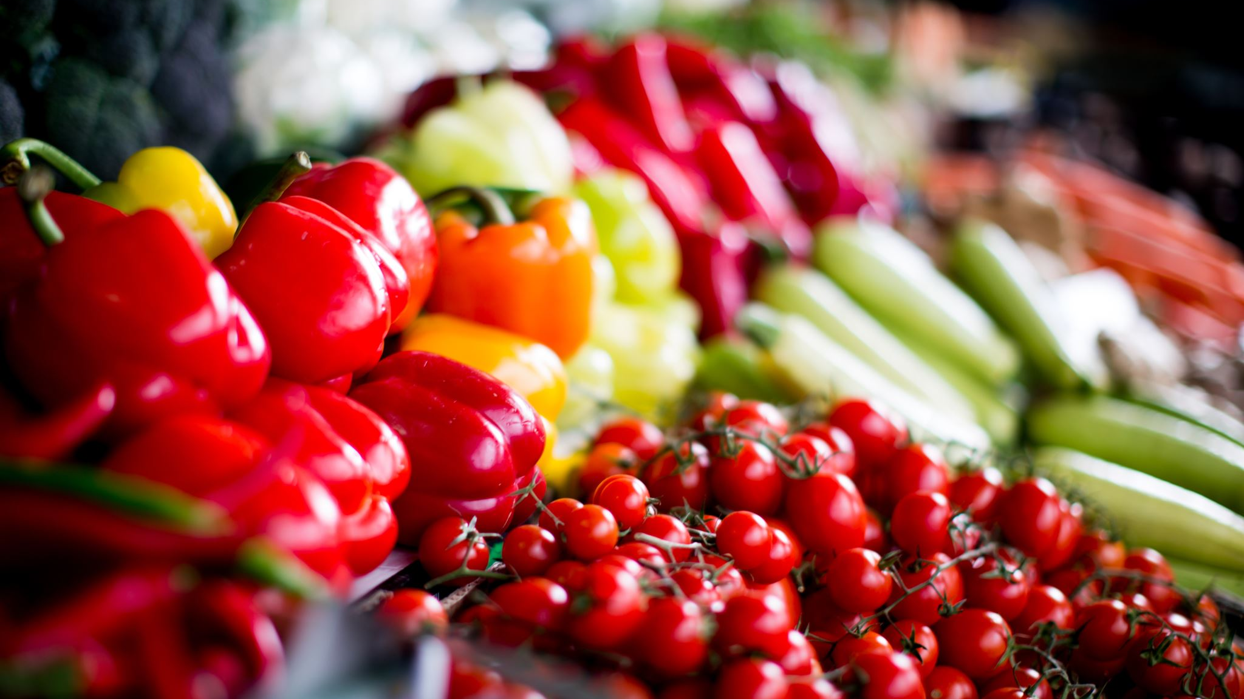
Does the rate of inflation for food purchased at grocery stores within California align with the rest of the United States?
z

Slide 6
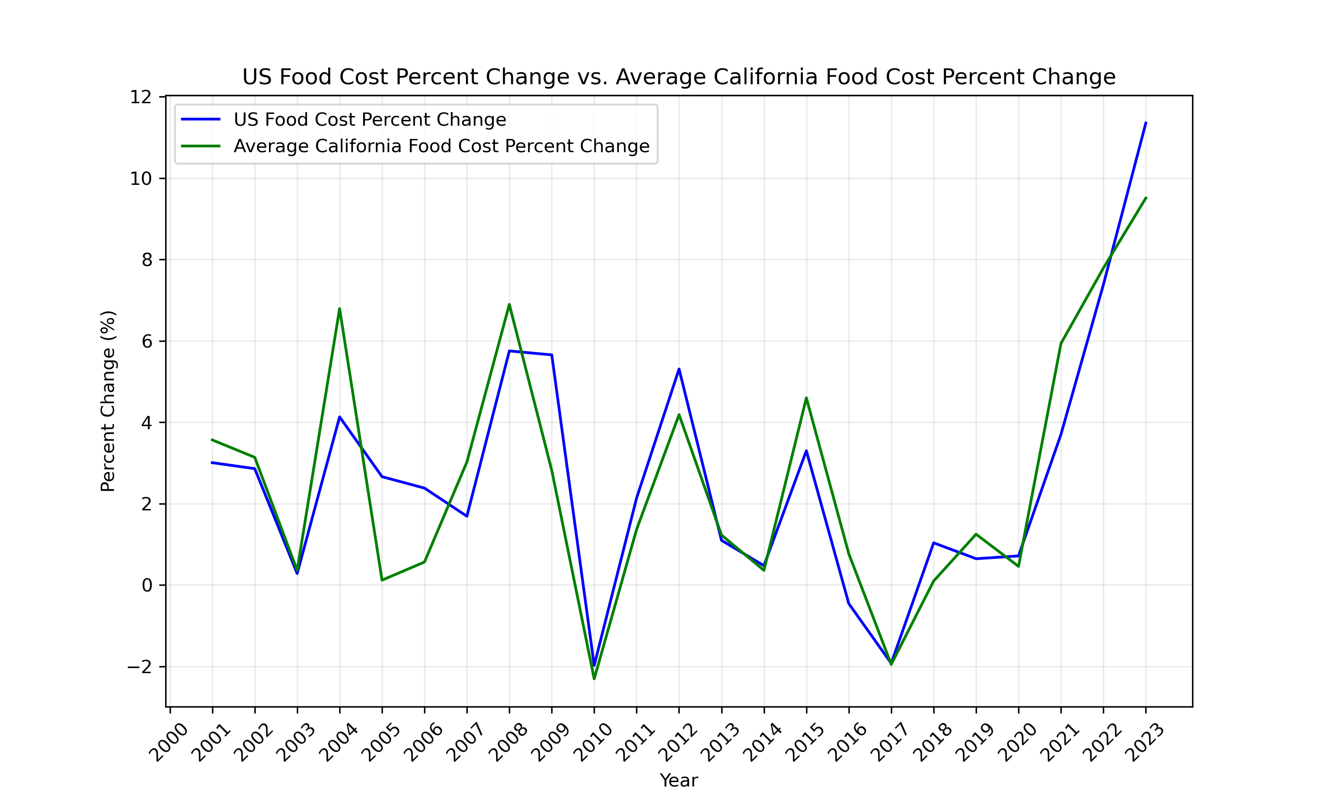
Grocery Inflation: California vs. the US
Notes:
- CA generally followed suit with the rest of the United States in terms of how much fluctuation of food prices we saw over the last 20 years
- Between the years 2002 and 2008, increased a bit more than the US, also decreased a bit more than the US

Slide 7
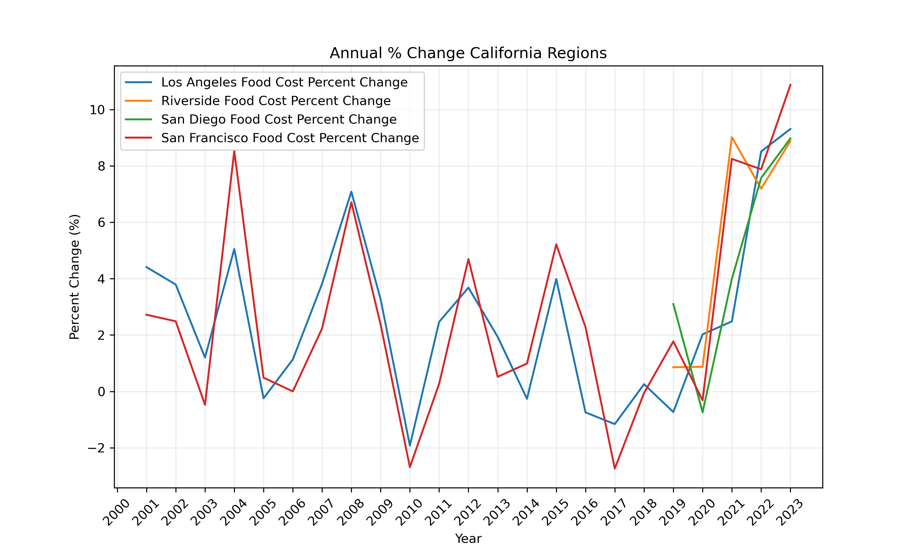
Grocery Inflation in the California Regions
Notes:
- Riverside and San Diego were not included until Dec 2017
- Within the CA regions, trends are fairly similar
- SF region saw greater increases and decreases in percent change

Slide 8
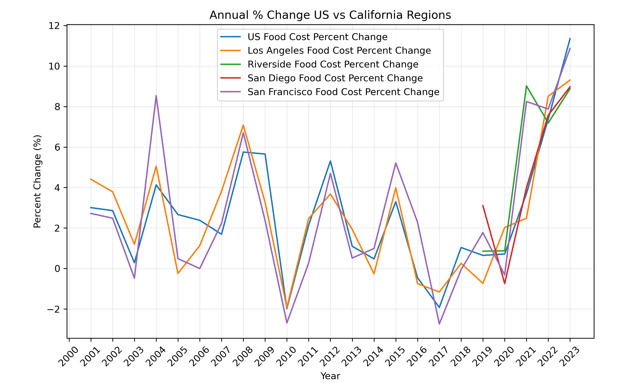
US vs. California Regions

Slide 9
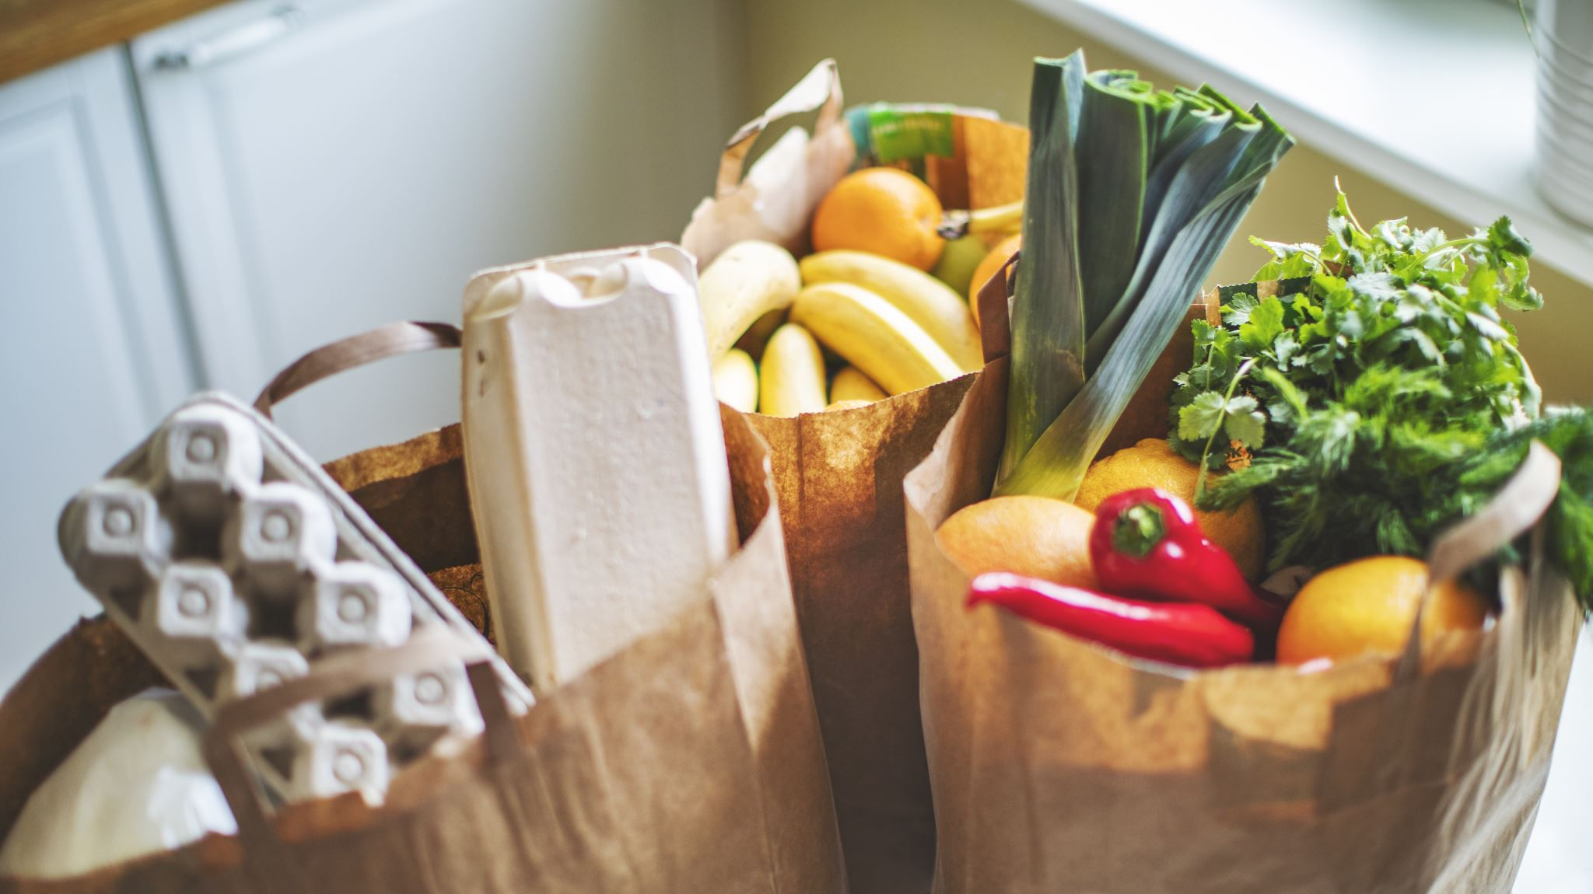
Do price increases vary with food type?
z

Slide 10
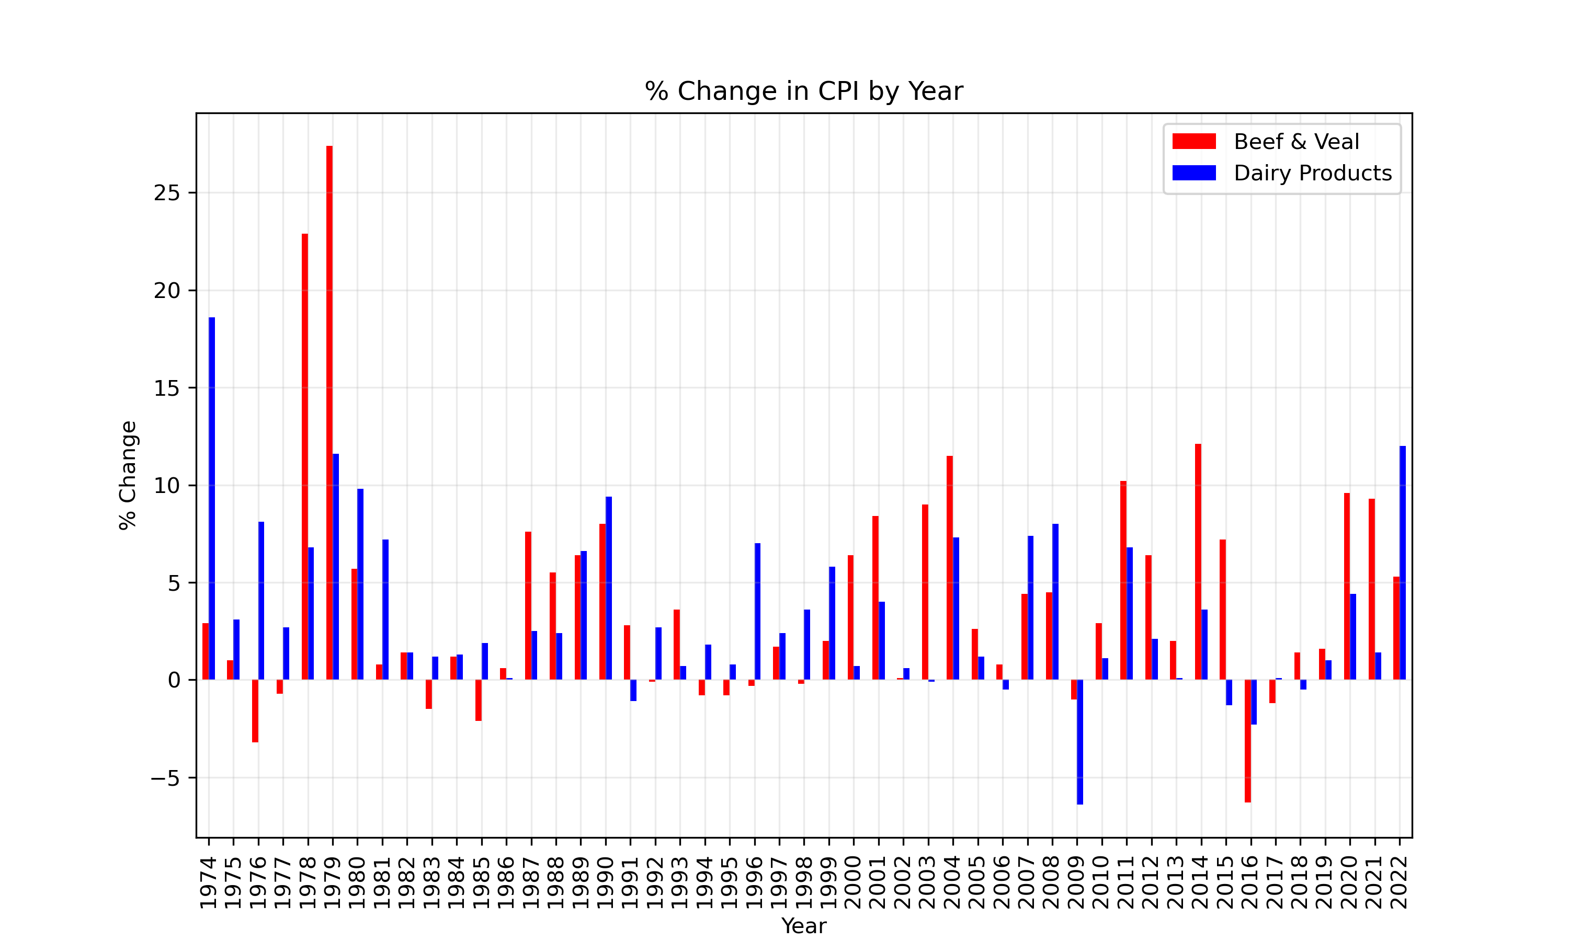
Beef & Veal vs. Dairy
Notes:
- Every 10 years, beef/veal category follows a pattern of an increased percent change and drastically dropping
- Dairy products seem to have a consistent ebb and flow of percent change. The percent change gradually increases and decreases over the course of 10 years
- Ex: beef market is determined by how fat we make the cows
- different cows for dairy products and cattle
- In 2009, dairy farmers faced an unprecedented financial catastrophe as the global recession took hold. With an abrupt decline in export market demand and an oversupply of milk in the world market, milk prices tanked. At the same time, dairy farmers were paying historically high feed costs.

Slide 11
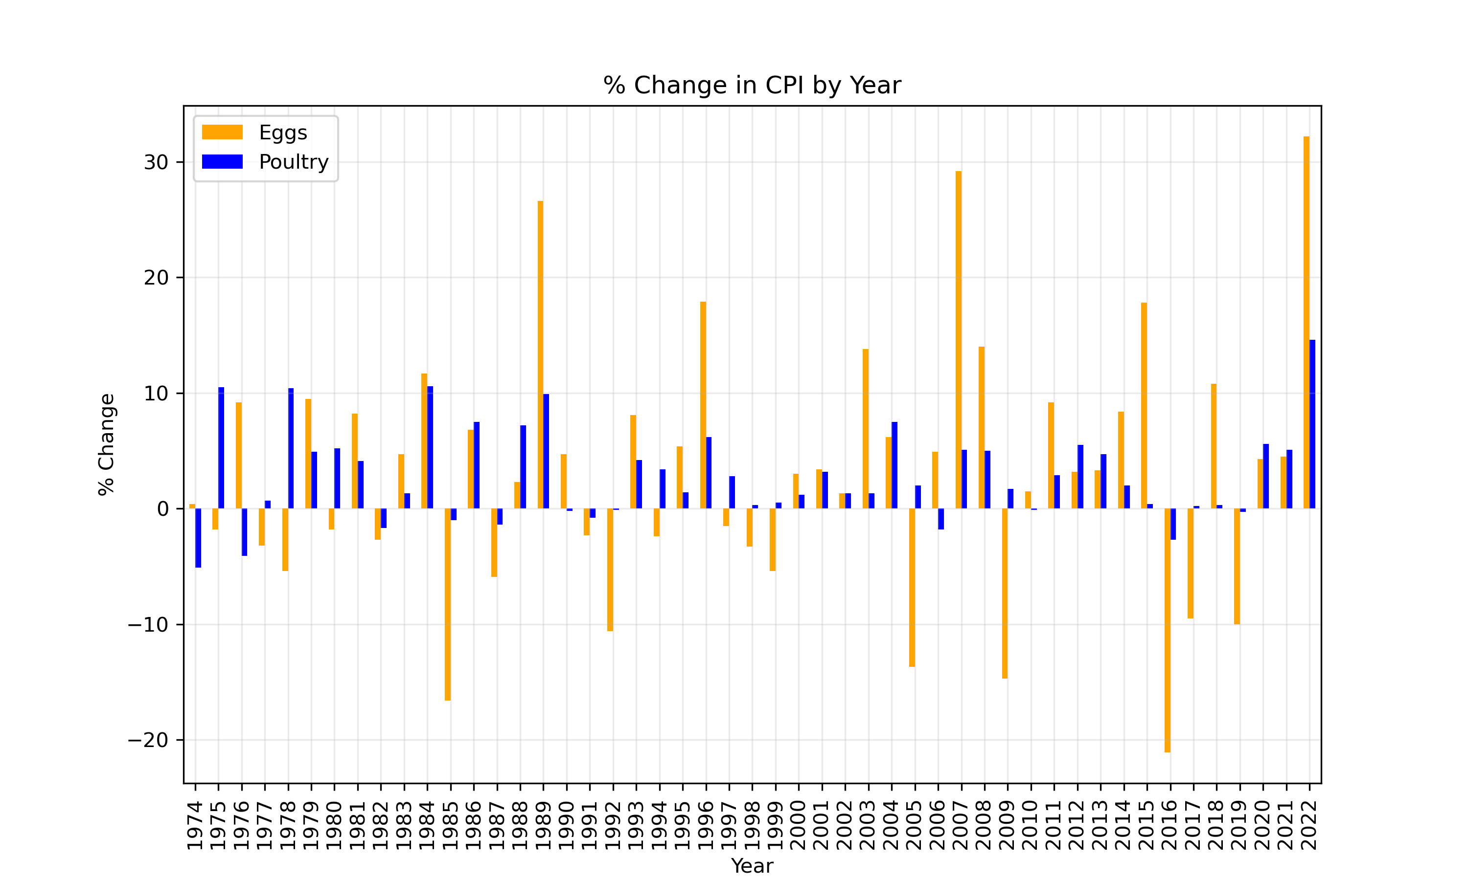
Eggs vs. Poultry
Notes:
- Percent change for poultry was relatively consistent
- Eggs all over the place, drastic increases and dips in price, no distinctive pattern
- things to consider:
- bird flu
- transportation and feed for chickens
- fluctuating supply/demand

Slide 12
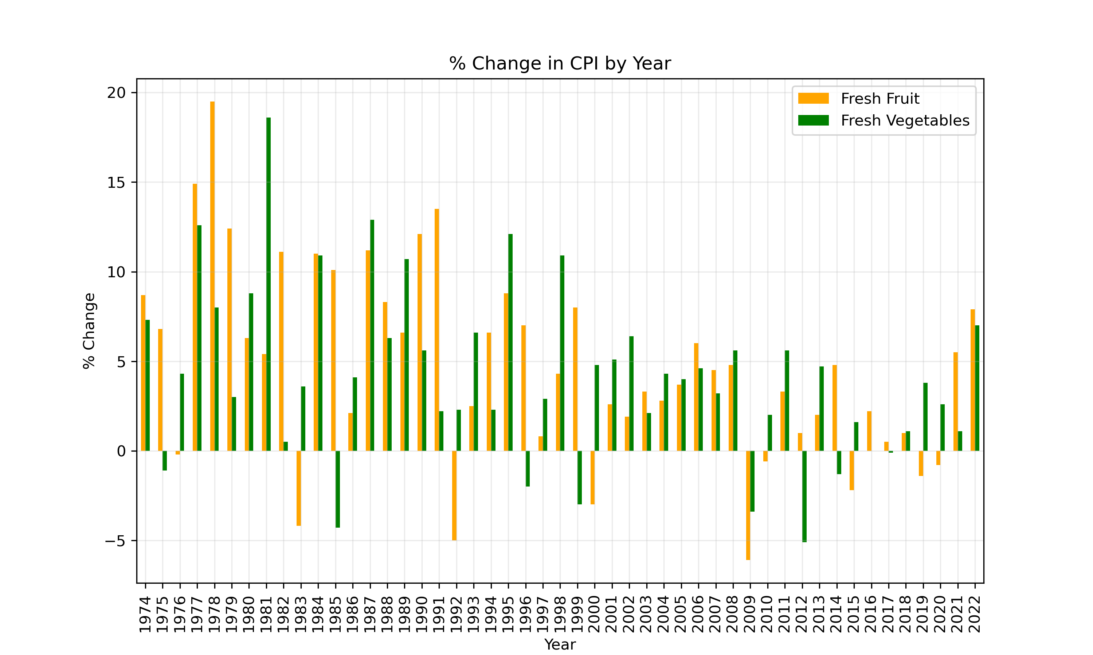
Fruits vs. Vegetables
Notes:
- Fruits and vegetables are generally aligned with each other
- climate change
- ex: CA drought

Slide 13
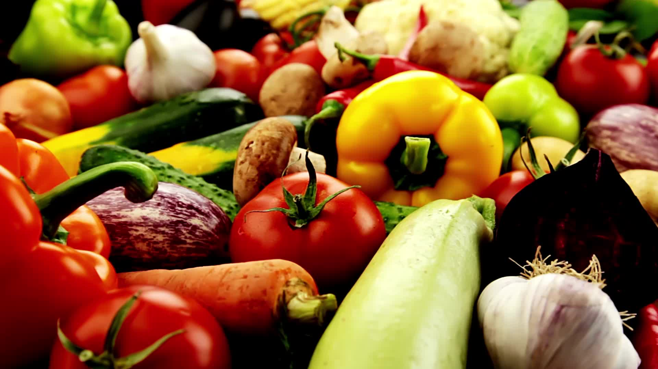
Where and when did we see the greatest variations in inflation for grocery items?
z

Slide 14
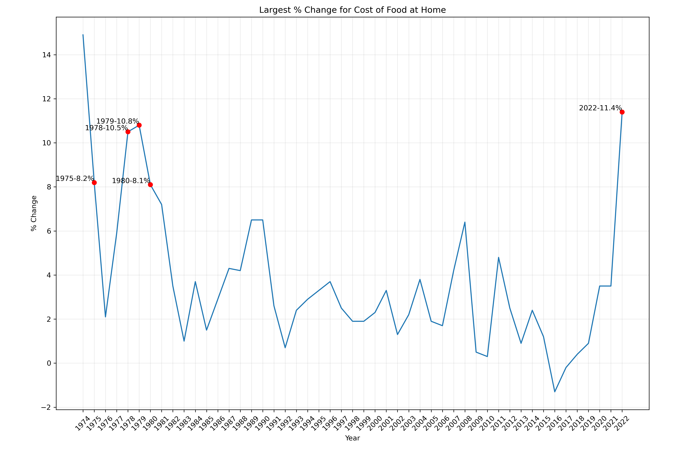
5 Greatest Percent Changes
Notes:
- NOT showing uptick of price

Slide 15
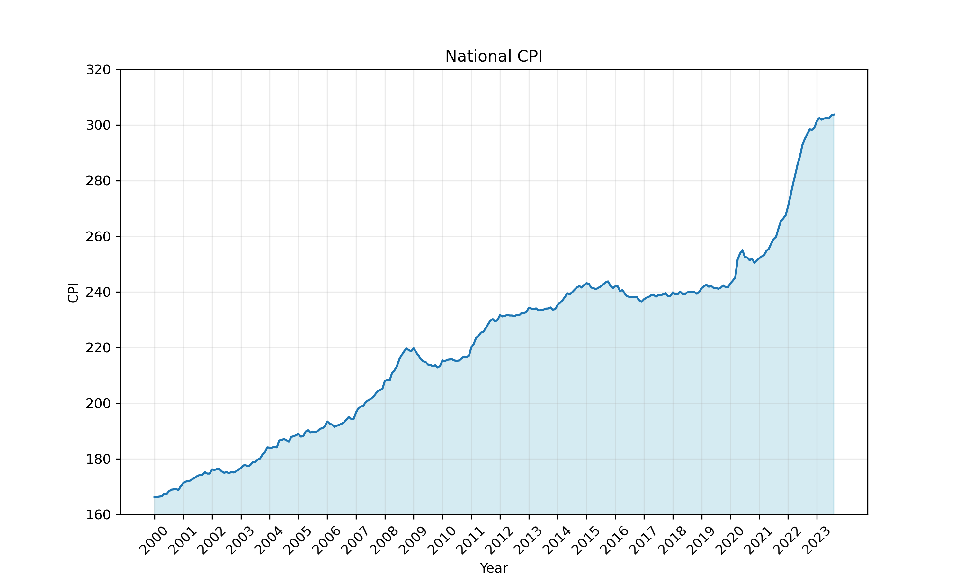
CPI Changes

Slide 16
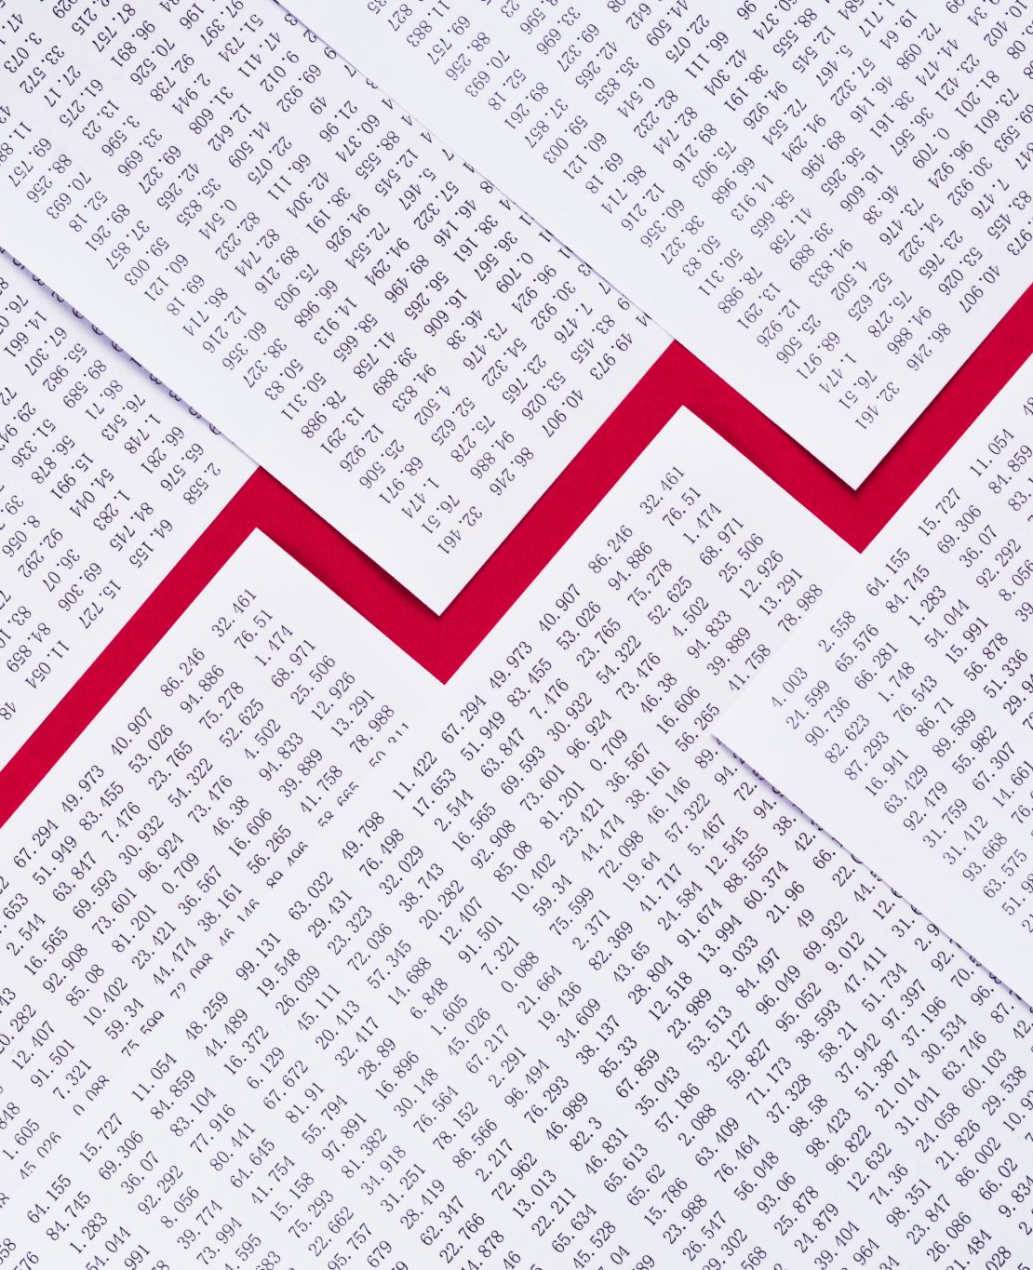
Well… What happened?
Late 70’s inflation cause by
Skyrocketing oil prices
Meat prices
Lifting of Nixon era price freezes
Steep inflation ended because interest rates were raised to 20% by Fed chairman Paul Volcker

Slide 17

What would we do if we had more time?
More research
Compared things that assumed would have more correlation, would like to examine more
Make predictions
Potentially use findings to provide recommendations for stores and/or restaurants

Slide 18

Questions?
z

